Slide 1
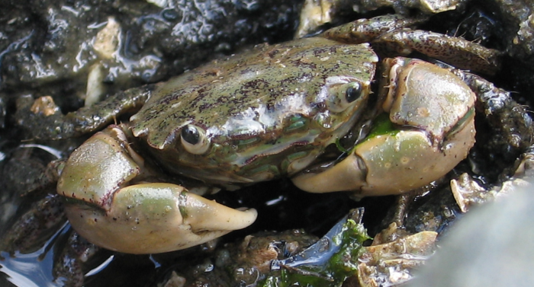
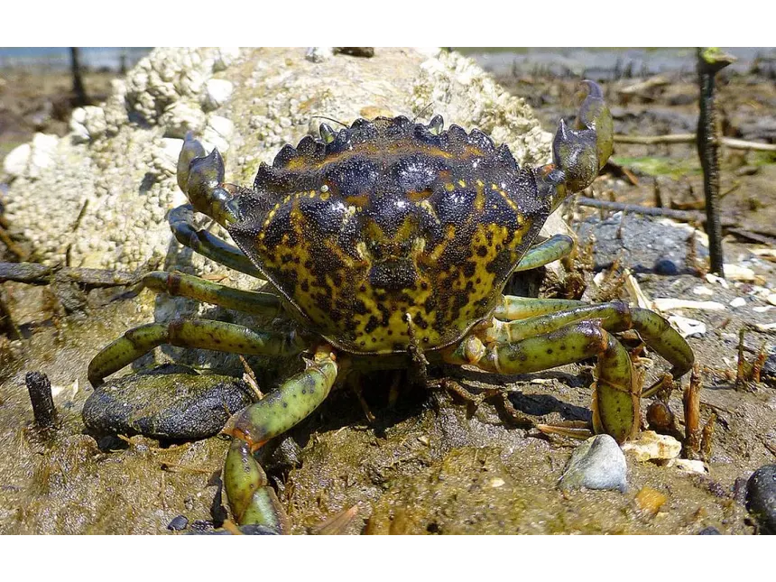
Effects of Elevated Water Temperature and Desiccation on Competing Intertidal Crabs, Hemigrapsus oregonensis and Carcinus maenas
Chloe Rusk, Rachel Kasbohm, Keely Rundle

Slide 2
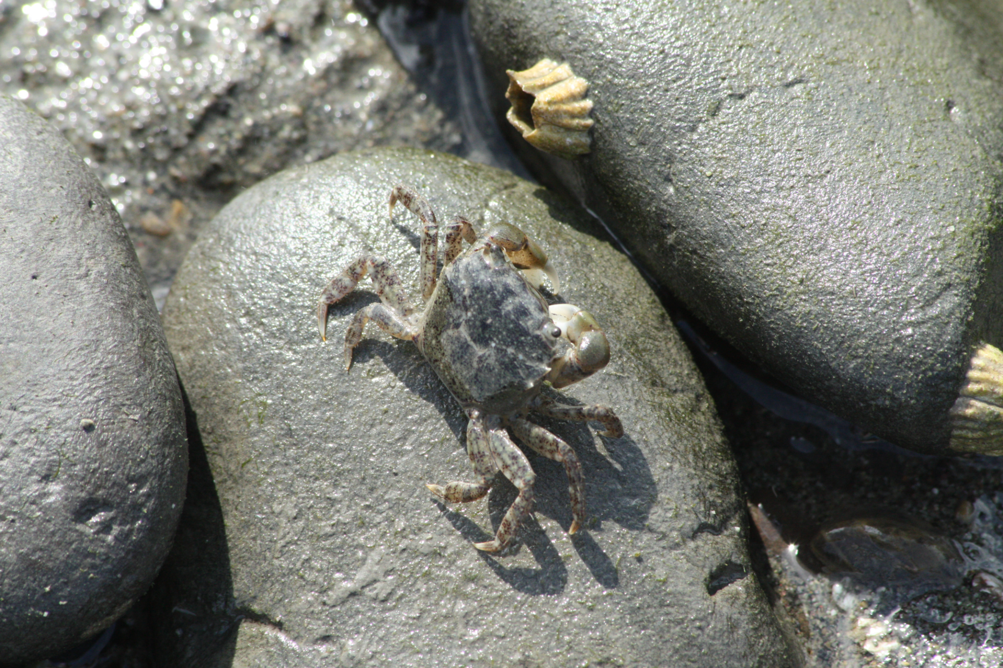
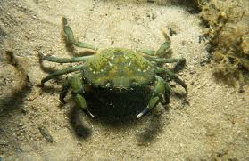
Background
Crabs
Hemigrapsus oregonensis
Carcinus maenas
Puget Sound
Seasonal temperature variation:
8 - 13°C
Climate change:
Expected to increase 0.5-1°C by 2050; max average of 19.6°C, minimum 8.7°C (Walker 2022).
Temperature/Desiccation
Effects:
Desiccation increases ‘felt’ temperature
Ectotherms – metabolism changes with temperature
H. oregonensis are stenotherms

Slide 3
Significance
Knowing the physiological tolerances of these two crabs allows us to:
Compare thermal tolerances
Estimate spatial ranges
This data has numerous applications, such as:
Informing conservation efforts
Determining the risk factor of invasive species on local fisheries

Slide 4
Introduction
Our study will focus on the effect of summer conditions on both H. oregonensis and C. maenas
Why summer conditions:
High temperatures both in and out of water
Increased temperature in tide pools
Summer conditions exacerbated by climate change
Why the effect on H. oregonensis and C. maenas:
Comparing the effects of a stressor on a native crab versus an invasive crab species
Can help inform how each species will respond to global warming
Important for native species conservation

Slide 5

How does temperature stress and desiccation affect the metabolic rate of Carcinus maenas and Hemigrapsus oregonensis?

Slide 6
Hypotheses
H₀: Temperature and desiccation will have no impact on crab metabolic rate.
H_{A1}: Metabolic rate, as a proxy for stress, will be higher in crabs exposed to elevated water temperatures while in the water and after desiccation.
H_{A2}: European green crabs Carcinus maenus will have a less extreme response to the stressors than hairy shore crabs Hemigrapsus oregonensis.

Slide 7
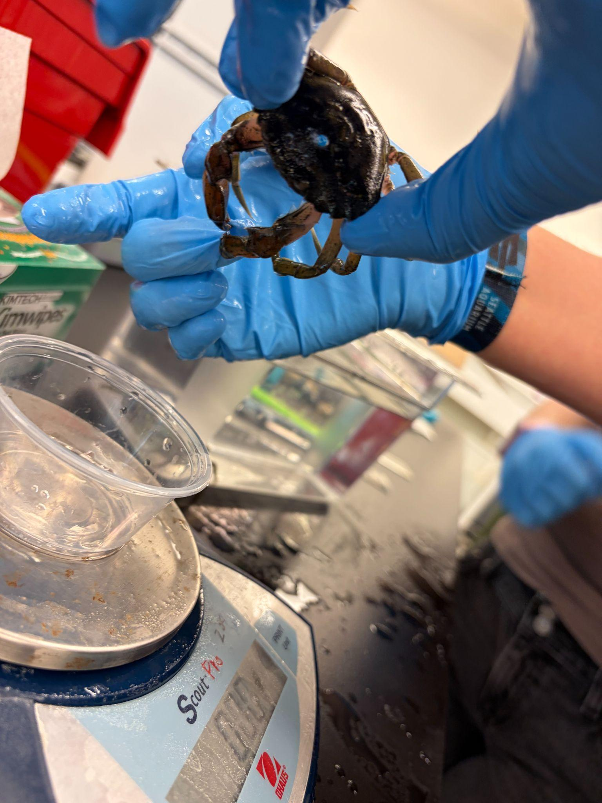
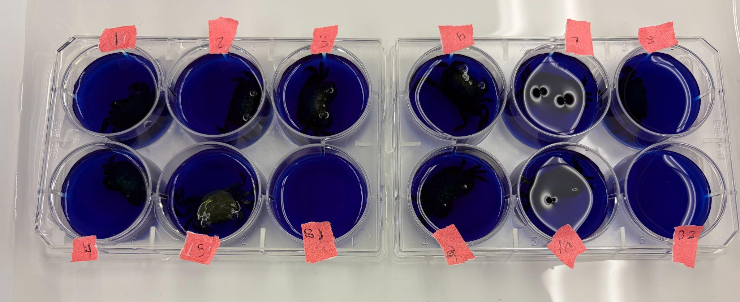
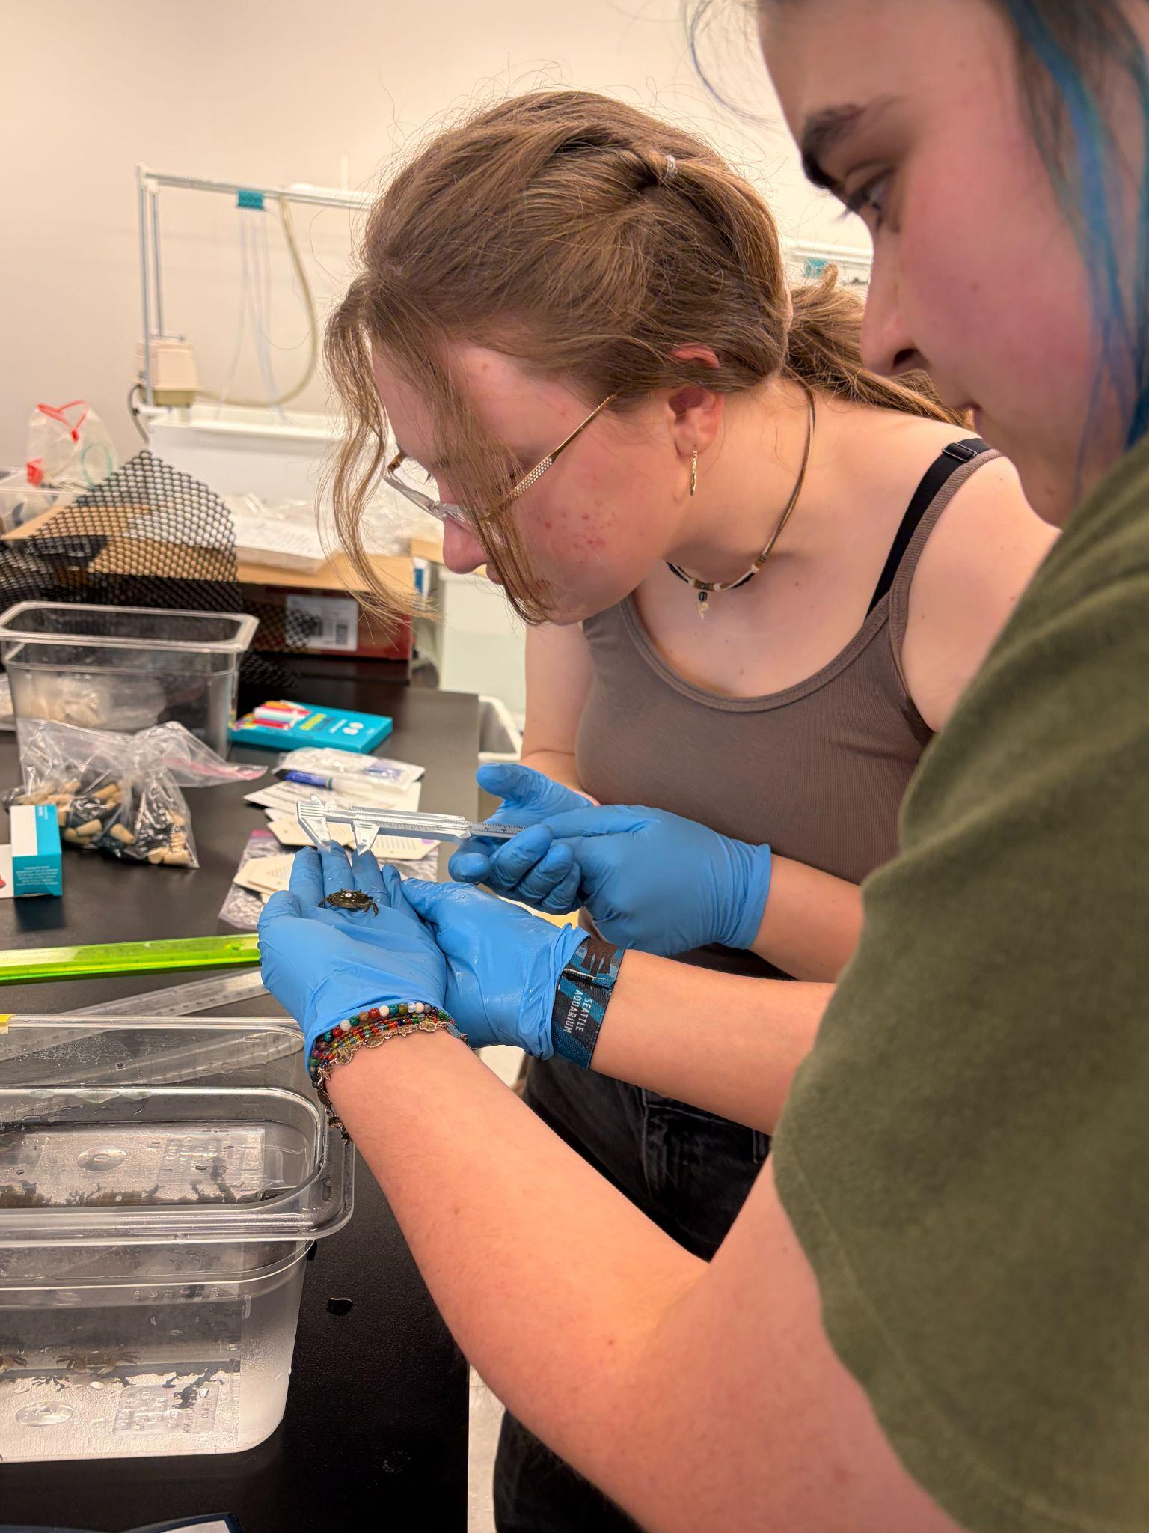
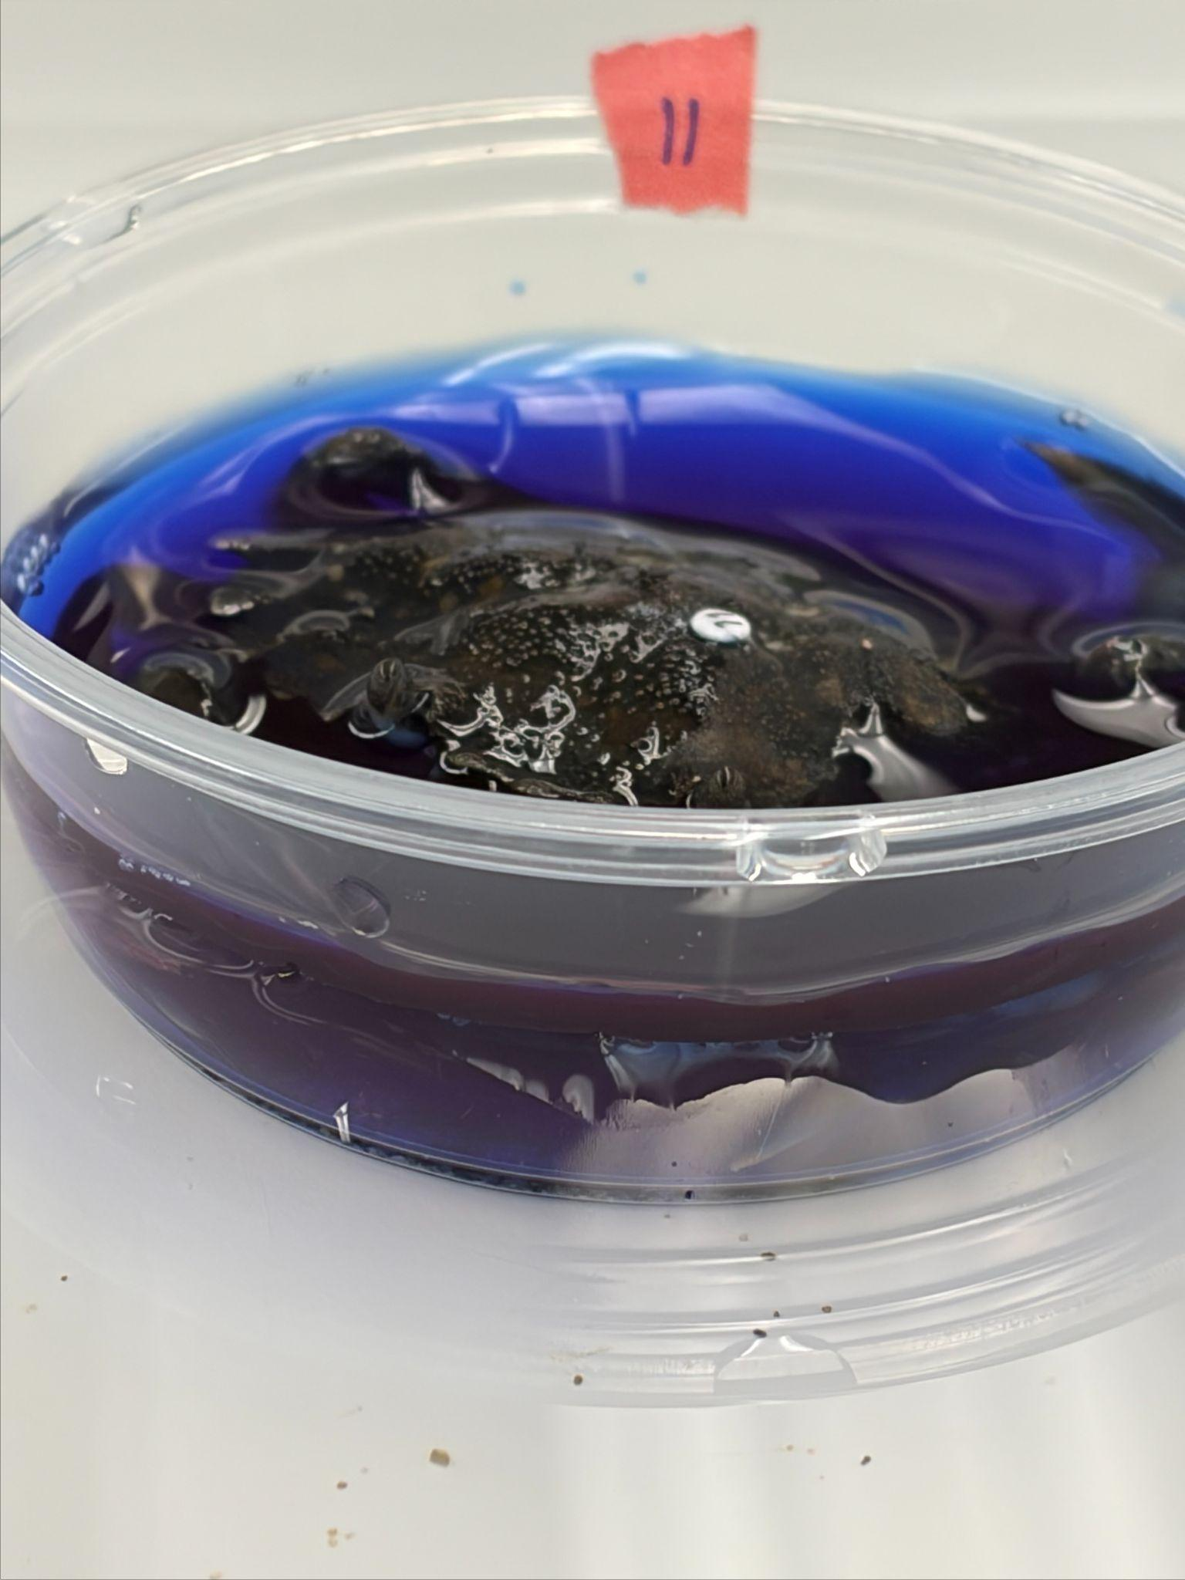
Methods I
Total: 12 Hemigrapsus oregonensis, 2 Carcinus maenas
Control group 5 H. oregonensis, 1 C. maenus
Experimental group 5 H oregonensis, 1 C. maenus
We had 2 mortalities of H. oregonensis, which were replaced with backup crabs one in the control group and one in the experimental group

Slide 8
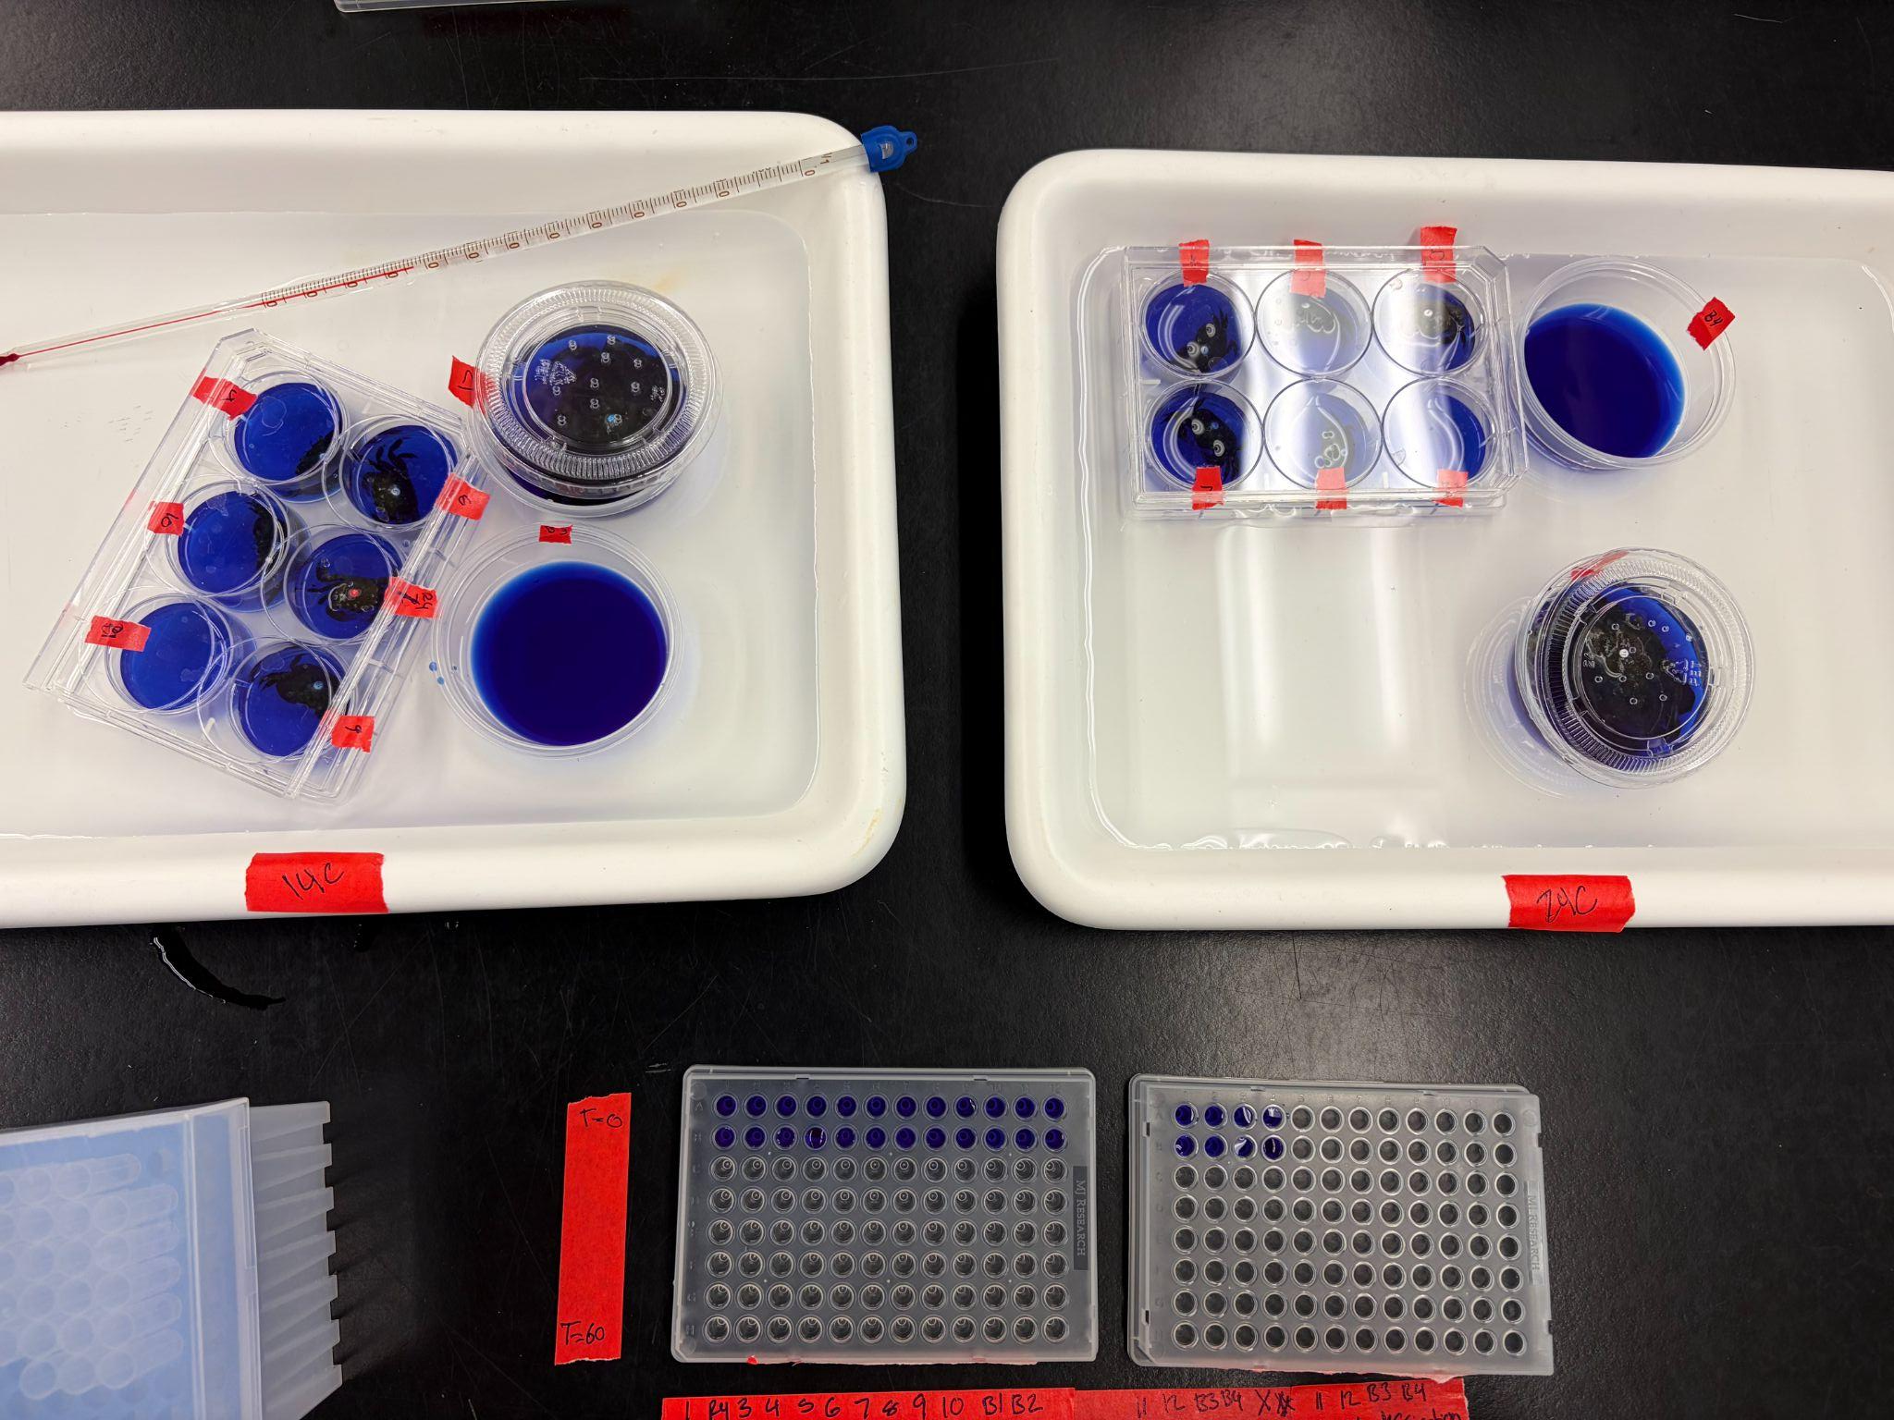
Methods II (First Lab Session)
Resazurin protocol: measured every 10 minutes for one hour
Resazurin wells placed in water baths to maintain temperature of 14 C
H. Oregonensis placed in six well plate using 8 ml resazurin
C. maenus in condiment cups using 40 ml resazurin

Slide 9
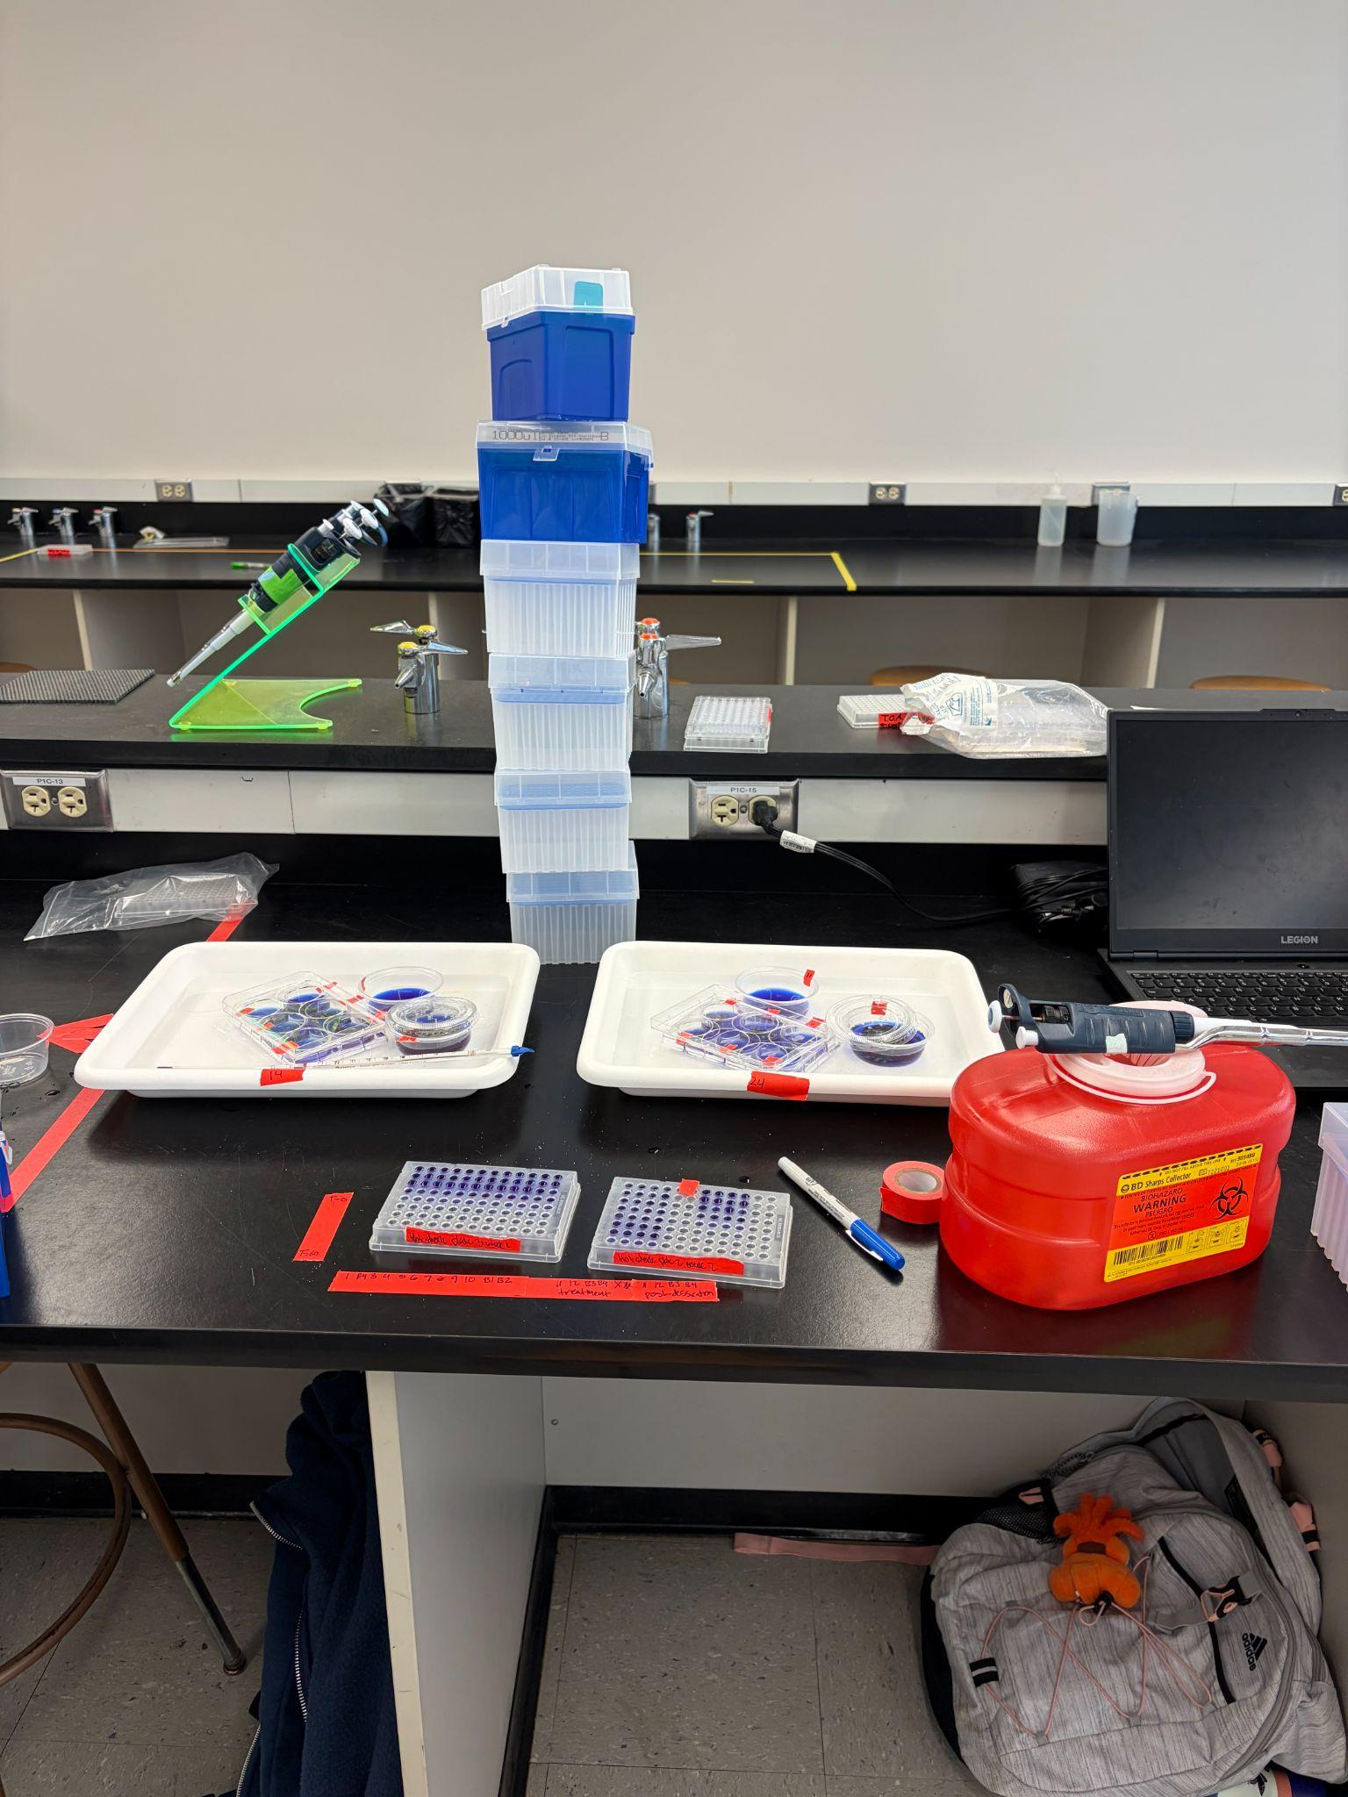
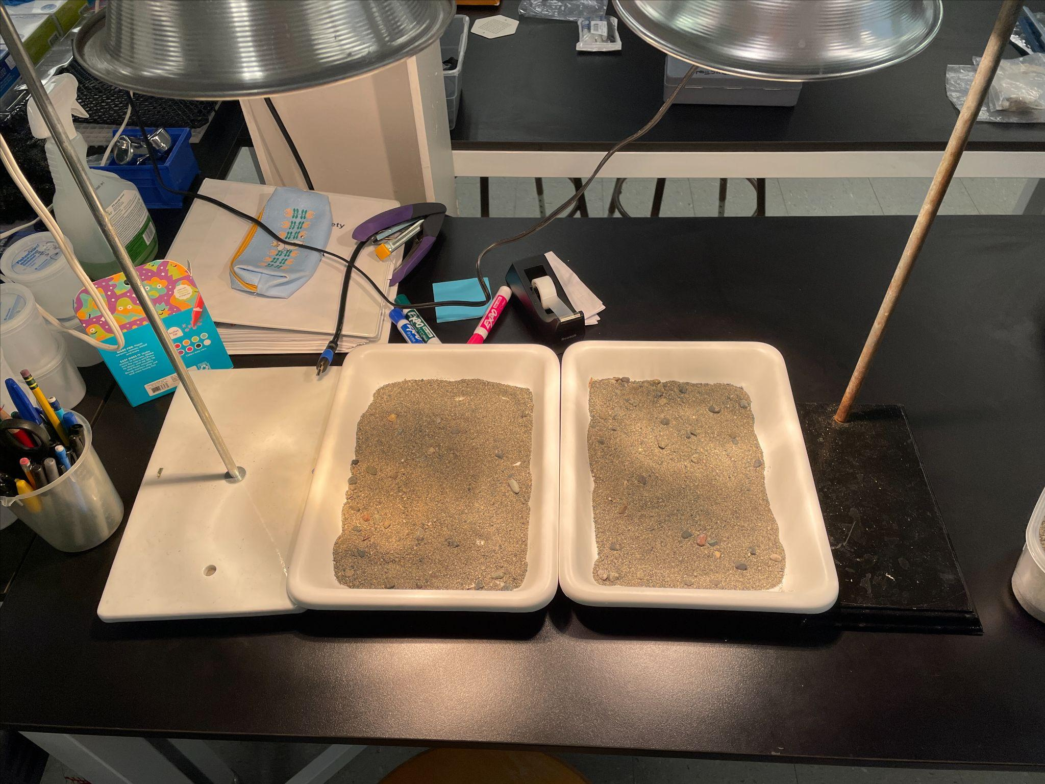
Methods III (Second and third lab sessions)
Reran resazurin protocol, dividing into control group held at 14 C and experimental group held at 24 C for one hour
Place crabs in heated corrals (substrate at 30C) for 30 minutes, separating shore crabs from green crabs
Returned crabs to resazurin treatments, at the same temperatures as in previous step for an additional hour

Slide 10
Methods IV (Data and analysis)
Carapace length*.
Crab weight will be used to normalize metabolic rates.
Actual temperatures of the water and the air and substrate temperatures under the heat lamp.
Used the fluorescence values to calculate a slope, this slope is the metabolic rate
Average the total change in metabolic rate between treatments (crab species, temperature, pre/post-desiccation) and the average metabolic rate
2-way ANOVA with a Tukey test
*Data not used in actual analysis, just for reference

Slide 11
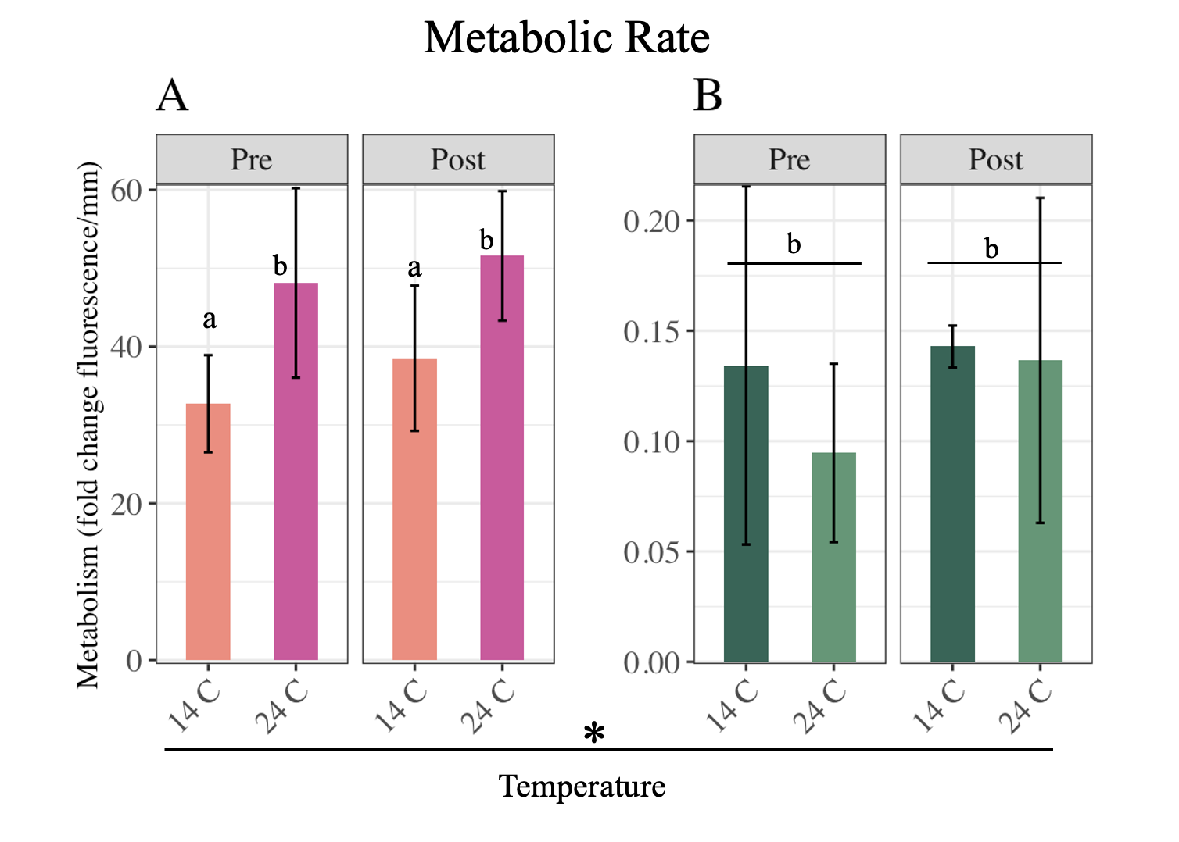
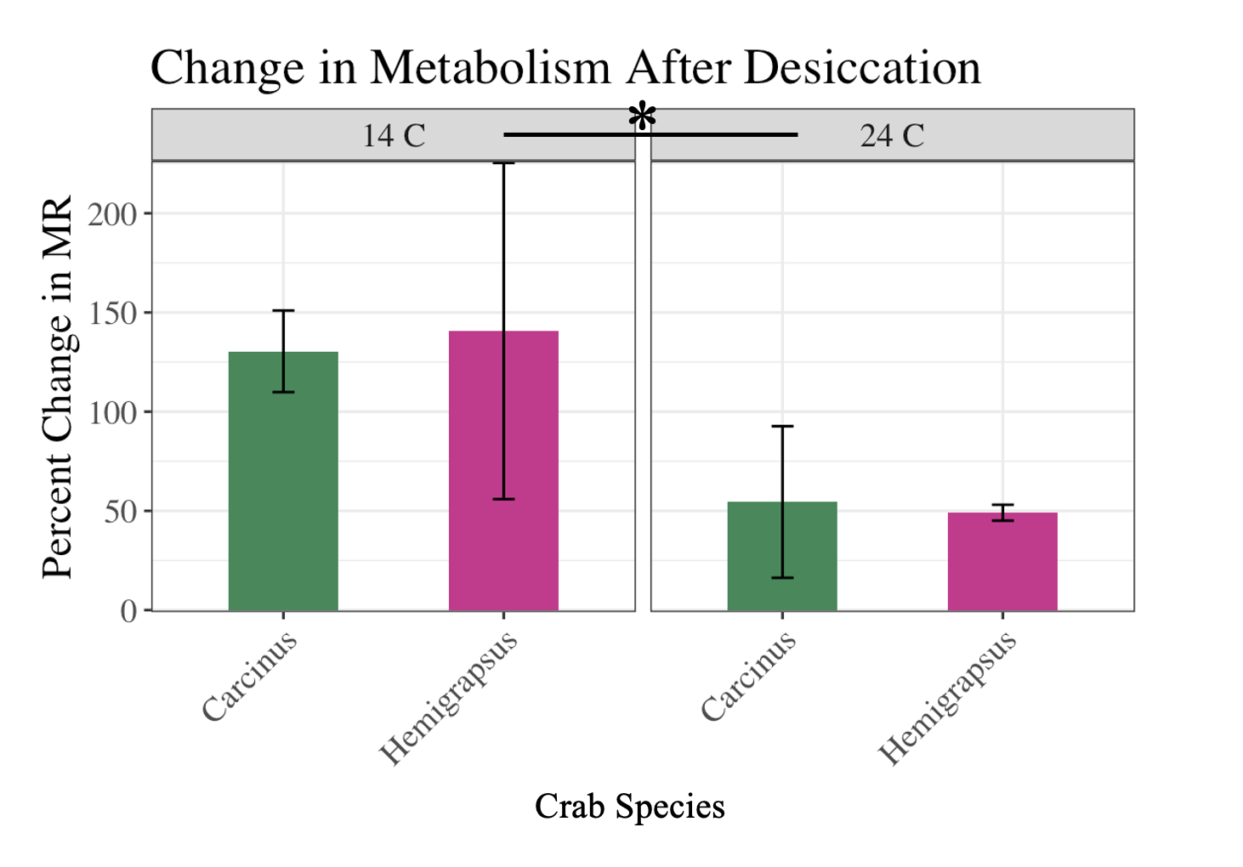
Results
Figure 2. Percent change in metabolic rate after desiccation of each crab species for the different temperature trials. Error bars indicate + SD. * p-val < 0.05 between the temperature trials.
Figure 1: Mean metabolic rate as fold change in resazurin fluorescence/mm for Hemigrapsus (A) and Carcinus (B) at different temperatures before (Pre) and after (Post) desiccation. The y-axis scale for the Carcinus is lower than the y-axis scale for Hemigrapsus due to the much lower overall metabolic rate. “a” is significantly different from “b” (p-val < 0.05). * p-val < 0.05. Error bars indicate + SD.

Slide 12
Discussion
Crabs held in cooler water are more susceptible to the effects of desiccation than those in warmer water.
Warm treatment crabs already had a high metabolic rate; difference after desiccation was likely less pronounced because of this.
Crabs exposed to desiccation after being in a cool tidal pool would experience more stress than those in a warm pool.
Hemigrapsus tended to have a higher metabolic rate overall, though Carcinus had a higher Q10 when calculated from the pre-desiccation rates (Hemigrapsus = 1.5, Carcinus = 6.4).
Could be a result of the lower metabolic rate for Carcinus overall; slight change seems more pronounced
Change in metabolic rate did not change significantly between species.
Carcinus metabolic rates decreased after desiccation, though not significantly so.
A potential response to stress? More replicates could potentially reveal a more significant relationship.

Slide 13
Future Studies
MORE GREEN CRABS!
Some results were not significantly different likely as a result of only having two EGCs
Measure metabolic rate during desiccation period.
Measure other stress proxies.
Hemolymph osmolality, proteins, heart rate, etc.
Compare lab results to a field study.
What are the rates in the wild?

Slide 14
Citations
Dehnel, P. A. (1960). Effect of Temperature and Salinity on the Oxygen Consumption of Two Intertidal Crabs. Biological Bulletin, 118(2), 215–249. https://doi.org/10.2307/1538998
Griffen, Blaine D, et al. “Variation in Metabolic Rate during Low Tide Aerial Exposure in the Asian Shore Crab Hemigrapsus Sanguineus.” Marine Biology, vol. 171, no. 6, 8 May 2024, https://doi.org/10.1007/s00227-024-04449-8.
TODD, M., DEHNEL, P., TODD, M.-E., & DEHNEL, P. A. (1960). EFFECT OF TEMPERATURE AND SALINITY ON HEAT TOLERANCE IN TWO GRAPSOID CRABS, HEMIGRAPSUS NUDUS AND HEMIGRAPSUS OREGONENSIS. Biological Bulletin., 118(1), 150–172.
Tepolt, C. K., and G. N. Somero. “Master of All Trades: Thermal Acclimation and Adaptation of Cardiac Function in a Broadly Distributed Marine Invasive Species, the European Green Crab, Carcinus Maenas.” Journal of Experimental Biology, vol. 217, no. 7, 26 Mar. 2014, pp. 1129–1138, https://doi.org/10.1242/jeb.093849. Accessed 24 Apr. 2020.
Walker, S., Mozaria-Luna, H. N., Kaplan, I., & Petatán-Ramírez, D. (2022). Future temperature and salinity in Puget Sound, Washington State, under CMIP6 climate change scenarios. Journal of Water and Climate Change., 13(12), 4255–4272.

